Slide 1
Welcome to 5th Grade
Mrs. Schaefer
Ms. Sturgeon
Mrs. Warner

Slide 2
Typical Day in 5th Grade (handout)
8:55-9:10 Homerooms
9:10-9:55 RATS (music, art, PE, computer lab, STEM)
10:00-10:25 Math Focused Instructional Time (FIT)
10:30-11:40 Period 1 - English Language Arts
11:45-12:55 Period 2 - Math
1:00-1:30 Lunch
1:35-2:30 Period 3 - Social Studies
2:35-3:00 Reading/Writing FIT (not on Wednesdays)
3:05-3:40 Recess/Dismissal

Slide 3
Focused Instructional Time (FIT)
Two FIT times:
10:00-10:25 Math focus
2:35-3:00 Reading and writing focus (not on Wednesdays)
Students receive small group instruction/remediation on certain skills based on where they are at that time.

Slide 4
Related Arts Rotations (handout)
Students will go to each Related Arts (RATS) once a week.
Rotations include Music, PE, Art, Computer, and STEM
TEAM

Slide 5
Essential Learnings for PE:
5.3.1 Participate in health-enhancing physical activity.
5.5.2 Perform activities safely and follow rules.
Activities: Fitness Testing, Football, Volleyball, Basketball, Striking Objects, Tumbling, Bowling, Roller Skating, Cycling
*September Roller Skating Payment and Permission Slip Due
*November Veterans’ Day Program
*February Jump Rope for Heart
*March Roller Skating (parent volunteers needed)
Skate Night at Franklin Skate Club
*May Field Day (parent volunteers needed)
Please have your child wear tennis shoes to PE.

Slide 6
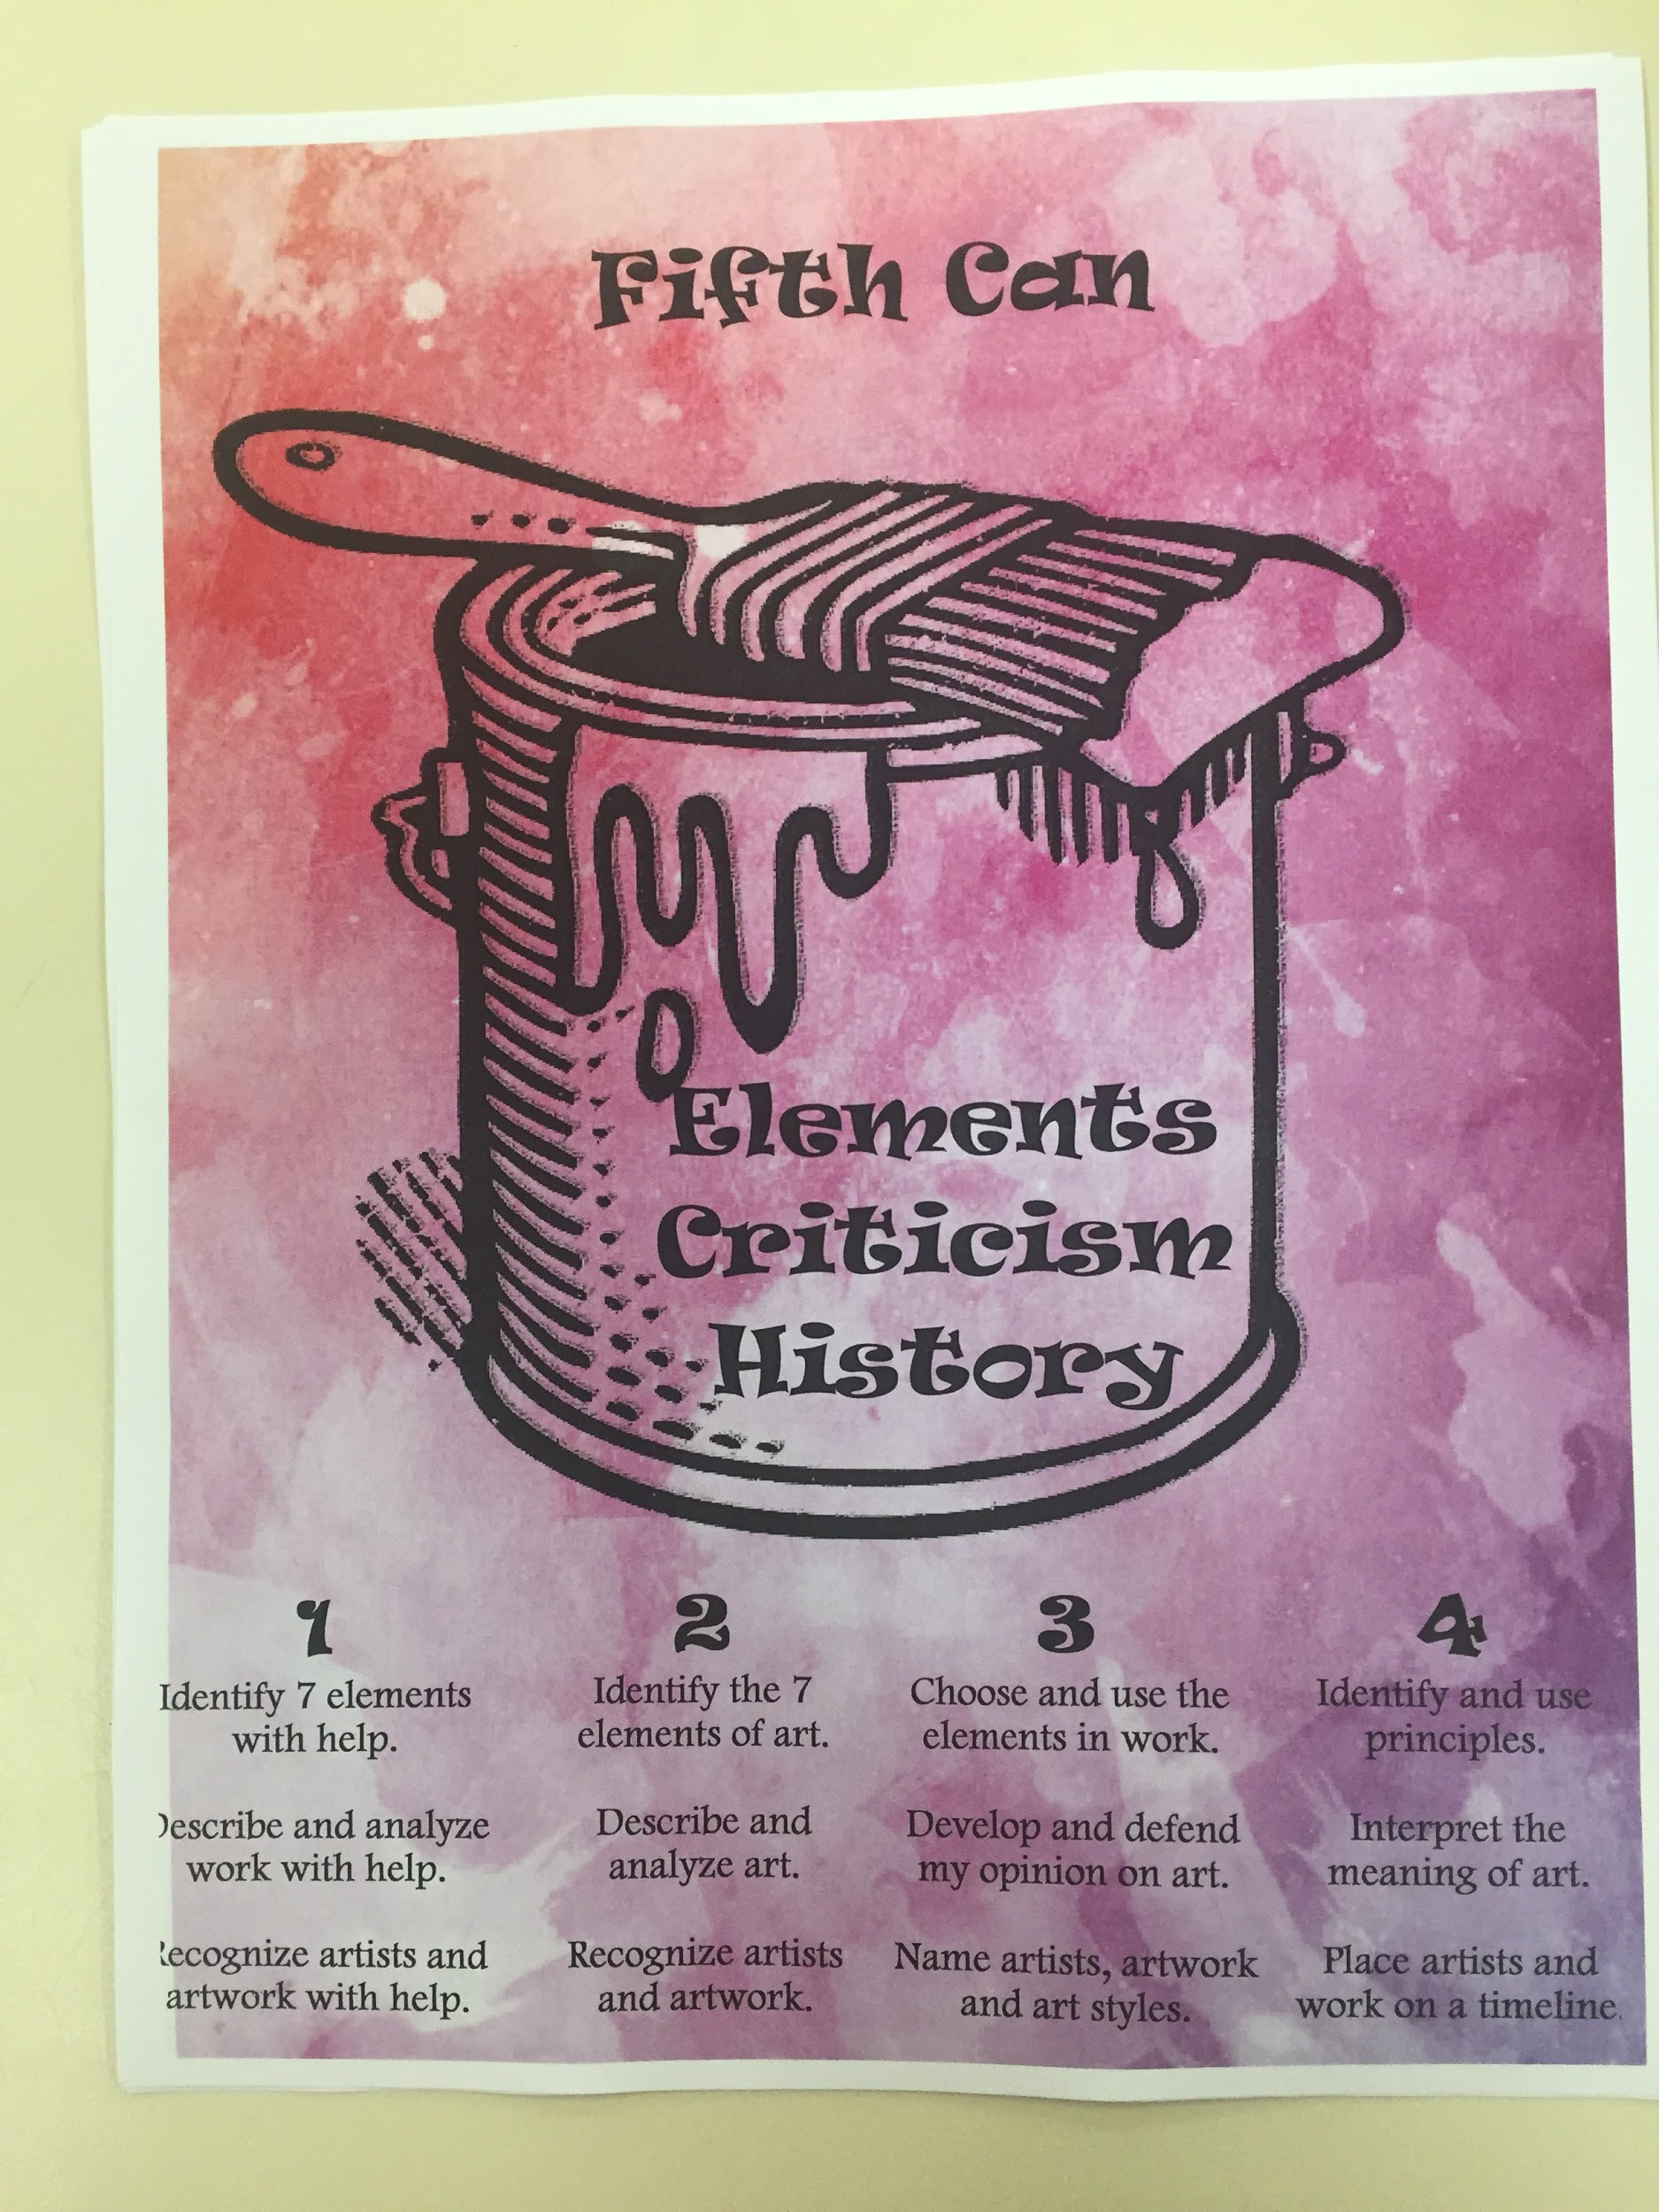
ART
We will focus on the elements of
Elements, Criticism and History.
Please send your kiddo in
something they can get dirty
in!!

Slide 7
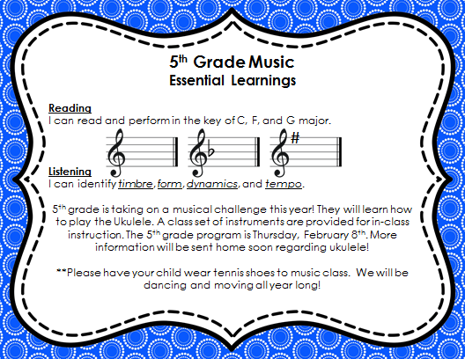

Slide 8
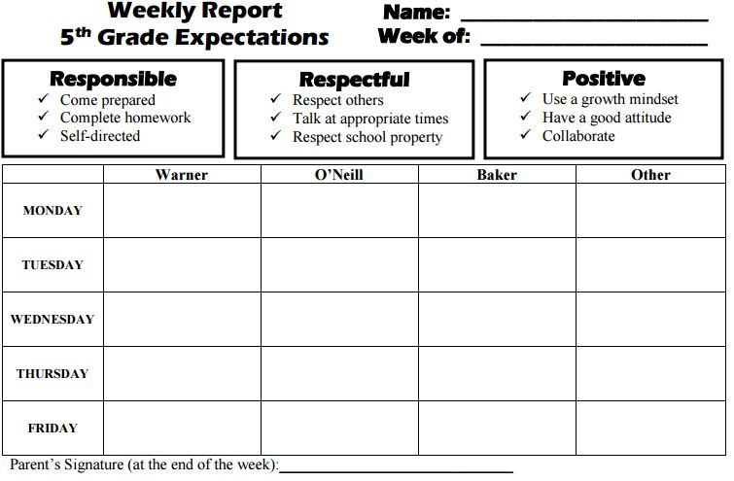
Behavior Charts
Based on the WES Warrior Way
Must be returned Monday morning with parent signature
Student earns an invite to our reward party every four weeks if he/she has two marks or less each week over that four-week period

Slide 9
Weekly Homework
Reading/Language Arts
Reading every night (Monday - Thursday)/ 1 writing activity due each week
Extra skill-based practice as needed
Math
1-2 assignments each week
Extra skill-based practice as needed
Social Studies/Science
Assigned as needed

Slide 10
What Students Need Every Day
Students must have the following items with them every day:
Trapper Keeper
Reading book
Any required homework
Missing any of these items may result in a mark on their behavior chart for not being prepared for class (Be Responsible).

Slide 11
Trapper Keepers
Trapper Keepers are carried with students to their classes for each period - so it is very important they have it every day.
All student on-going work and class notes are kept in their Trapper Keepers.
All papers MUST stay in it. Please do not clear out your child’s Trapper Keeper.
Papers that can stay at home will be stored in the orange vinyl folder, which will be stored in their Trapper Keepers.

Slide 12
Snacks
Students don’t eat lunch until 1 p.m., so a healthy snack to eat in Period 1 is welcome
Healthy snacks are crackers, fruit, cheese, yogurt, or veggies
No cookies, candies, chips, or anything that would create a mess

Slide 13
Water Bottles
Water bottles are also welcome so long as they have a screw lid
Only water please; flavored drinks can cause a sticky mess if spilled
If students are disruptive or preoccupied with having water bottles, they will be asked to not bring them to school

Slide 14
Essential Learning (EL) Scales
These are skills that have been identified by teachers that students must have to be ready for the next grade and for the state-wide ISTEP tests at the end of the year.
These are the skills that are reported out to parents on:
Mid-term reports (4 times a year - mid quarter)
Report cards (4 times a year - quarter end)
Data folders (twice monthly) - will come home first time with midterm (August 31)

Slide 15
Essential Learning (EL) Scales
5th Grade ELs can be found:
In your child’s data folder (kid-friendly version)
5th Grade Class Website
Corporation Essential Learnings page

Slide 16
Classroom Communication
Class Dojo -- using for communication ONLY
Not signed up, please see us tonight
You will need to be connected to 3 classes:
English/LA
Math
HR/SocSt/Science

Slide 17
Thank you For Coming!
We will post this slide-show to our 5th Grade Website and a link on our class story page on Class Dojo.
Questions?

